Slide 1
CENG401 MACHINE LEARNING AND ARTIFICIAL INTELLIGENCE
WEEK-10
MACHINE LEARNING
Logistic Regression
Nonlinear Regression
And
Classification
Algorithms
Asst.Prof.Dr. Murat ŞİMŞEK

Slide 2
Supervised Learning
Karan Kathpalia

Slide 3
Logistic Regression
Hypothesis representation
Cost function
Logistic regression with gradient descent
Regularization
Multi-class classification

Slide 4
Logistic Regression (Classification)

Slide 5
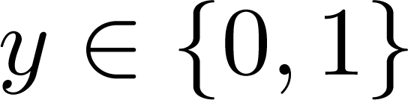
Classification
Email: Spam / Not Spam?
Online Transactions: Fraudulent (Yes / No)?
Tumor: Malignant / Benign ?
0: “Negative Class” (e.g., benign tumor)
1: “Positive Class” (e.g., malignant tumor)

Slide 6


1 (Yes)
Malignant?
Threshold classifier output $h_{θ}\left(x\right)$ at 0.5
If $h_{θ}\left(x\right)≥0.5,$ predict “$y=1$”
If $h_{θ}\left(x\right)<0.5$, predict “$y=0$”
0 (No)
Tumor Size
$$h_{θ}\left(x\right)=θ^{⊤}x$$

Slide 7
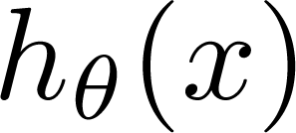
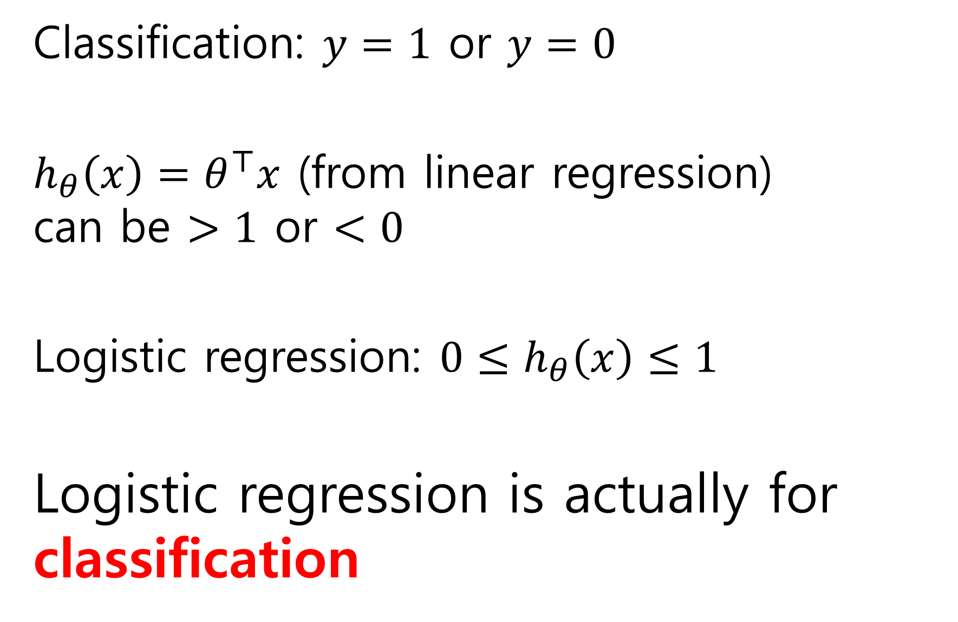
Classification: $y=1$ or $y=0$
$h_{θ}\left(x\right)=θ^{⊤}x$ (from linear regression) can be $>1$ or $<0$
Logistic regression: ${0≤h}_{θ}\left(x\right)≤1$
Logistic regression is actually for classification
can be > 1 or < 0

Slide 8
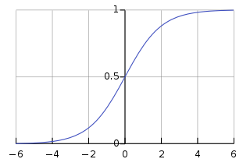
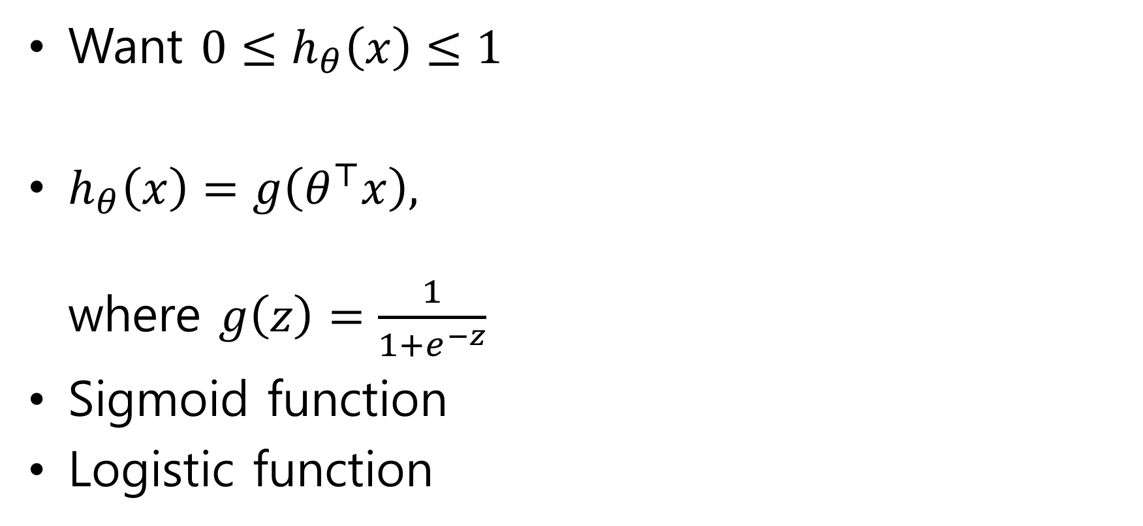


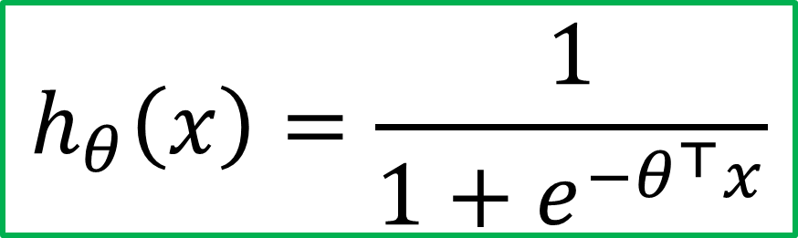
Hypothesis representation
Want ${0≤h}_{θ}\left(x\right)≤1$
$h_{θ}\left(x\right)=g\left(θ^{⊤}x\right),$ where $g\left(z\right)=\frac{1}{1+e^{−z}}$
Sigmoid function
Logistic function
$$h_{θ}\left(x\right)=\frac{1}{1+e^{−θ^{⊤}x}}$$
$$g(z)$$
$$z$$

Slide 9
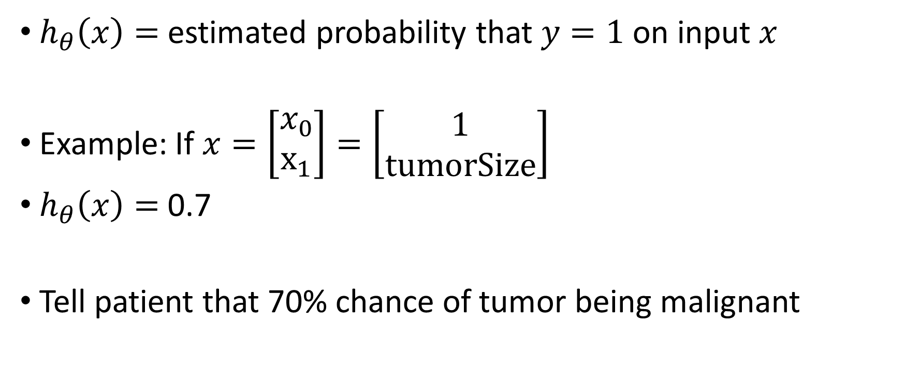
Interpretation of hypothesis output
$h_{θ}\left(x\right)=$ estimated probability that $y=1$ on input $x$
Example: If $x=\left[\begin{aligned}x_{0} \\ x_{1}\end{aligned}\right]=\left[\begin{aligned}1 \\ tumorSize\end{aligned}\right]$
$h_{θ}\left(x\right)=$ 0.7
Tell patient that 70% chance of tumor being malignant

Slide 10



Logistic regression
$$h_{θ}\left(x\right)=g\left(θ^{⊤}x\right)$$
$$g\left(z\right)=\frac{1}{1+e^{−z}}$$
Suppose predict “y = 1” if $h_{θ}\left(x\right)≥0.5$
${z= θ}^{⊤}x≥0$
predict “y = 0” if $h_{θ}\left(x\right)<0.5$
${z= θ}^{⊤}x<0$
$$g(z)$$
$$z=θ^{⊤}x$$

Slide 11
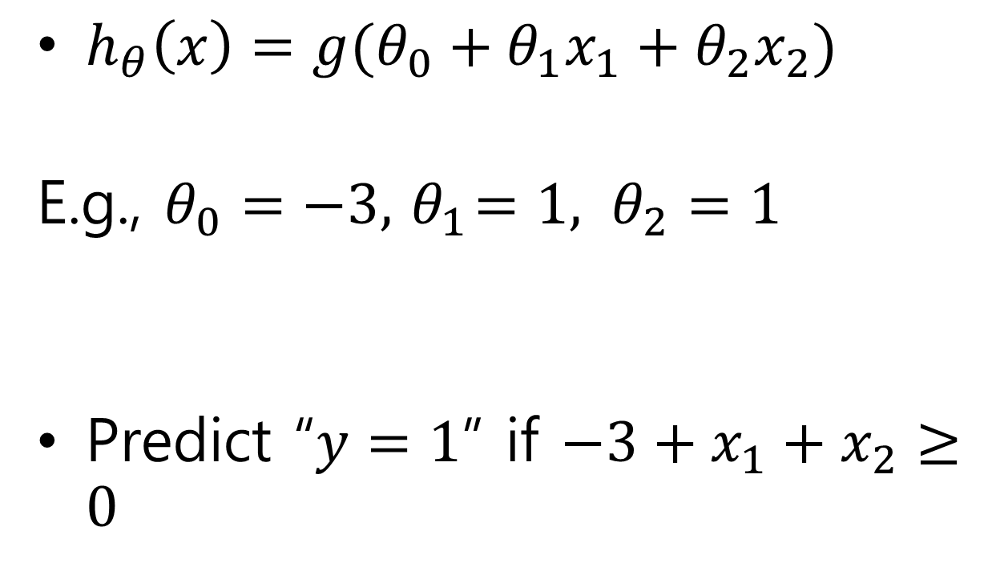
Decision boundary
$h_{θ}\left(x\right)=g(θ_{0}+θ_{1}x_{1}+θ_{2}x_{2})$
E.g., $θ_{0}=−3, { θ}_{1}=1, θ_{2}=1$
Predict “$y=1$” if $−3+x_{1}+x_{2}≥0$
Age
Tumor Size

Slide 12
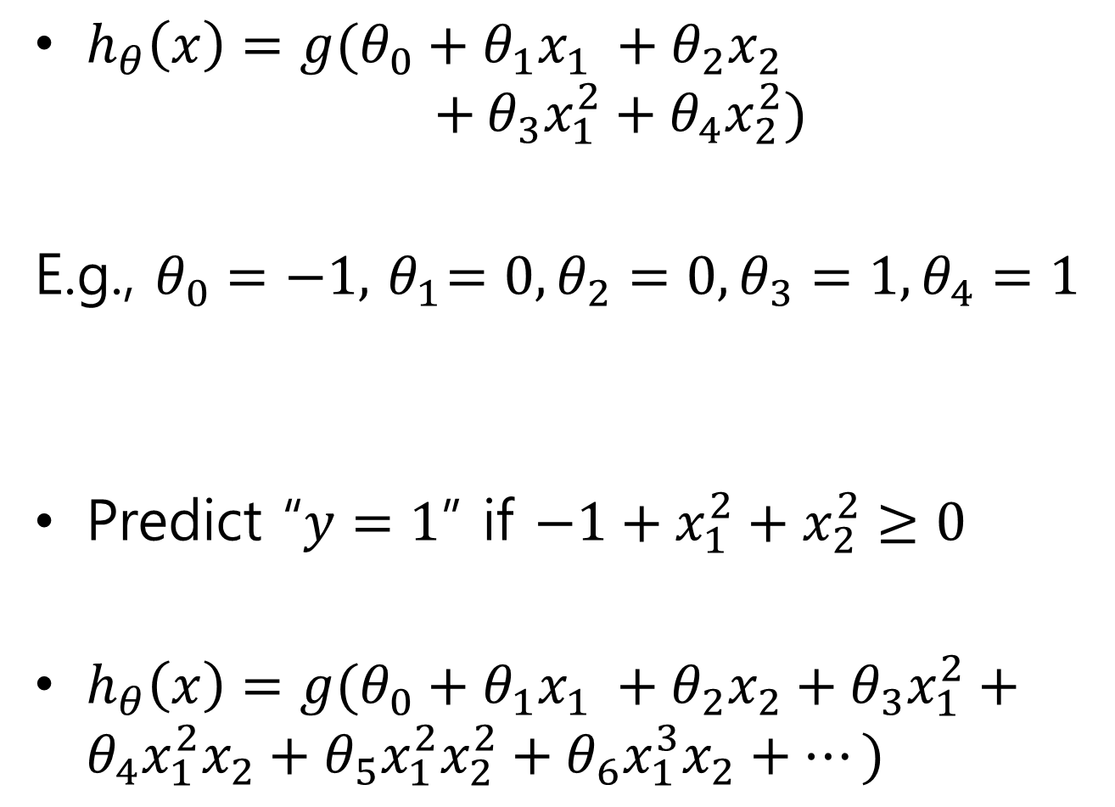
$h_{θ}\left(x\right)=g(θ_{0}+θ_{1}x_{1} +θ_{2}x_{2}$ $+$ $θ_{3}x_{1}^{2}+θ_{4}x_{2}^{2})$
E.g., $θ_{0}=−1, { θ}_{1}=0, θ_{2}=0,θ_{3}=1, θ_{4}=1$
Predict “$y=1$” if $−1+x_{1}^{2}+x_{2}^{2}≥0$
$h_{θ}\left(x\right)=g(θ_{0}+θ_{1}x_{1} +θ_{2}x_{2}+$ $θ_{3}x_{1}^{2}+θ_{4}x_{1}^{2}x_{2}+θ_{5}x_{1}^{2}x_{2}^{2}+θ_{6}x_{1}^{3}x_{2}+⋯)$

Slide 13
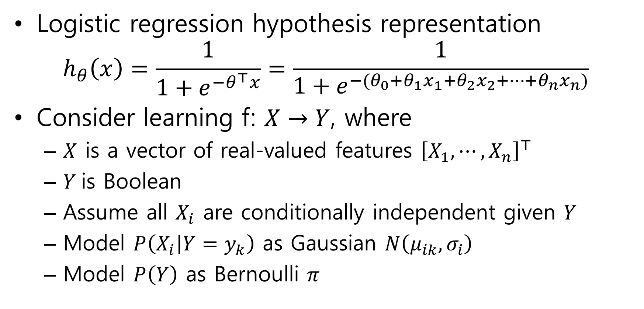

Where does the form come from?
Logistic regression hypothesis representation
$$h_{θ}\left(x\right)=\frac{1}{1+e^{−θ^{⊤}x}}=\frac{1}{1+e^{−(θ_{0}+θ_{1}x_{1}+θ_{2}x_{2}+⋯+θ_{n}x_{n})}}$$
Consider learning f: $X→Y$, where
$X$ is a vector of real-valued features ${\left[X_{1}, ⋯,X_{n}\right]}^{⊤}$
$Y$is Boolean
Assume all $X_{i}$ are conditionally independent given $Y$
Model $P\left(X_{i} | Y=y_{k}\right)$ as Gaussian $N\left(μ_{ik}, σ_{i}\right)$
Model $P\left(Y\right)$ as Bernoulli $π$
What is $P\left(Y|X_{1},X_{2}, ⋯,X_{n}\right)$?

Slide 14
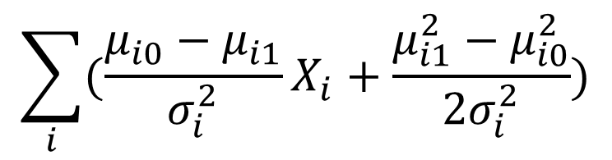
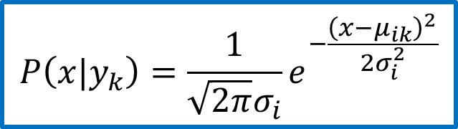



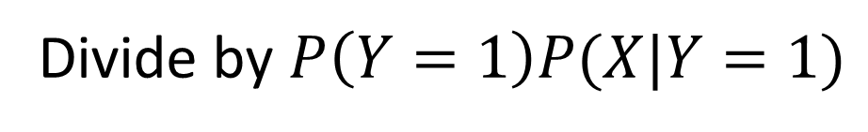
$P\left(Y=1|X\right)=\frac{P\left(Y=1\right)P(X|Y=1)}{P\left(Y=1\right)P(X|Y=1) +P(Y=0)P(X|Y=0)}$
$=\frac{1}{1+\frac{P\left(Y=0\right)P(X|Y=0)}{P\left(Y=1\right)P(X|Y=1)}}$
$= \frac{1}{1+exp(ln⁡(\frac{P\left(Y=0\right)P(X|Y=0)}{P\left(Y=1\right)P(X|Y=1)} ))}$
$=$ $\frac{1}{1+exp(\ln\left(\frac{1−π}{π}\right)+\sum_{i}{ln} \frac{P(X_{i}|Y=0)}{P(X_{i}|Y=1)})}$
$$P\left(Y=1|X_{1},X_{2}, ⋯,X_{n}\right)=\frac{1}{1+exp(θ_{0}+\sum_{i}{θ_{i}}X_{i})}$$
Applying Bayes rule
Divide by $P\left(Y=1\right)P(X|Y=1)$
Apply $exp⁡(ln⁡(⋅))$
Plug in $P(X_{i}|Y)$
$$P\left(x|y_{k}\right)=\frac{1}{\sqrt{2π}σ_{i}}e^{−\frac{{\left(x−μ_{ik}\right)}^{2}}{2σ_{i}^{2}}}$$
$$\sum_{i}{(\frac{μ_{i0}−μ_{i1}}{σ_{i}^{2}}}X_{i}+\frac{μ_{i1}^{2}−μ_{i0}^{2}}{2σ_{i}^{2}})$$

Slide 15
Logistic Regression
Hypothesis representation
Cost function
Logistic regression with gradient descent
Regularization
Multi-class classification

Slide 16
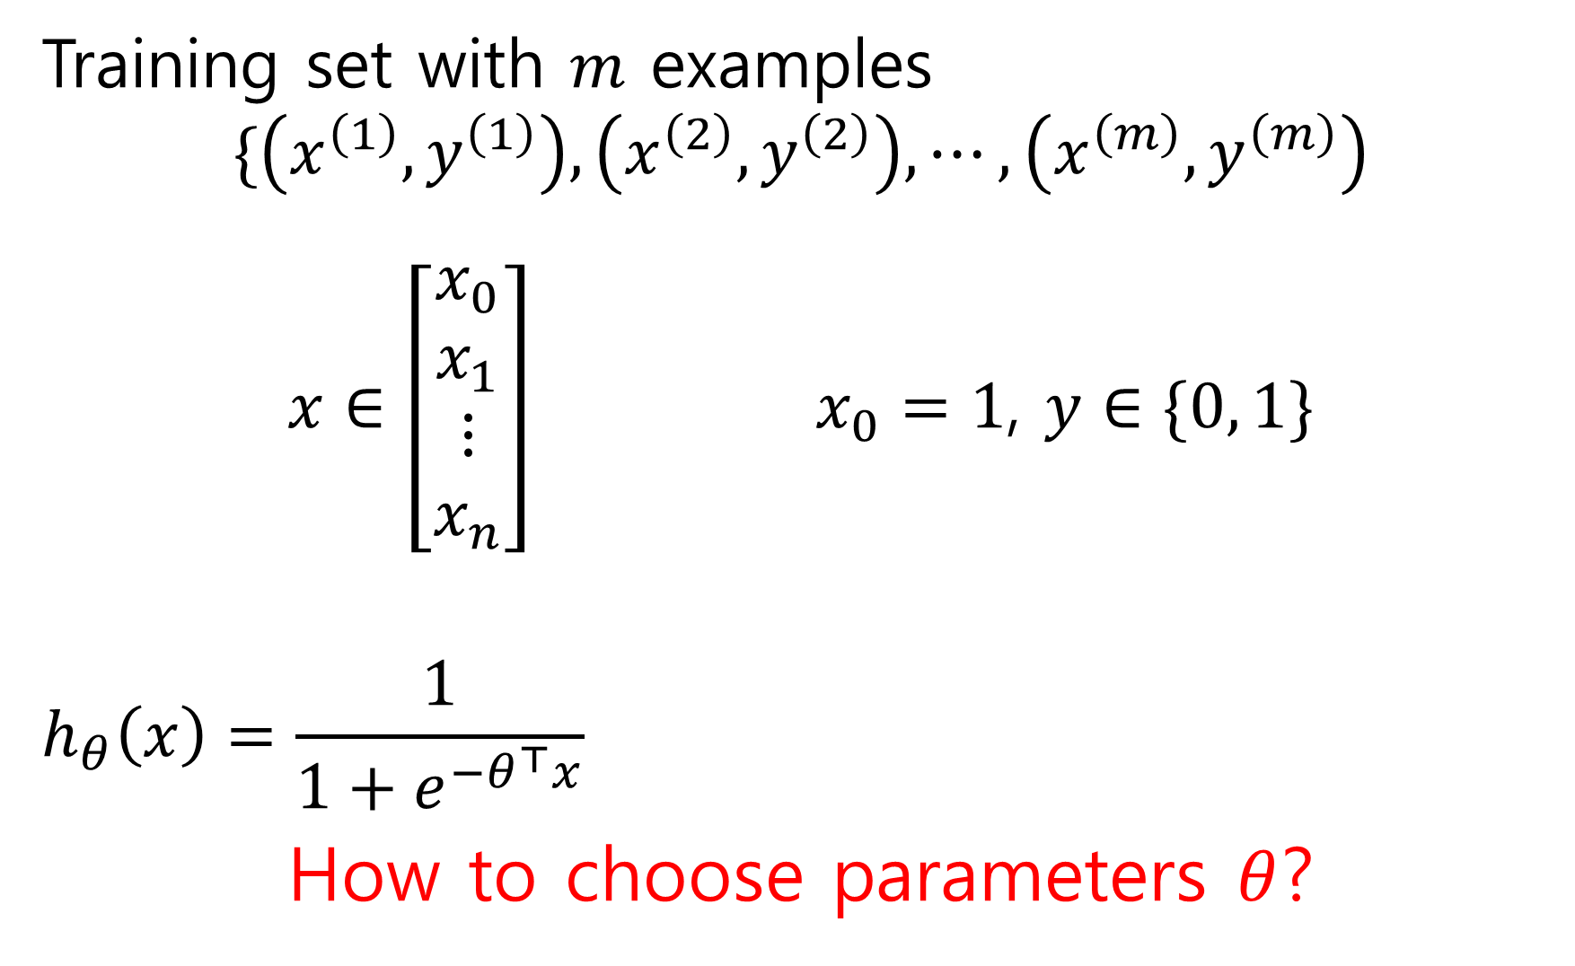
Training set with $m$ examples
$$\{\left(x^{\left(1\right)}, y^{\left(1\right)}\right), \left(x^{\left(2\right)}, y^{\left(2\right)}\right), ⋯,\left(x^{\left(m\right)}, y^{\left(m\right)}\right)$$
$x∈\left[\begin{aligned}x_{0} \\ x_{1} \\ ⋮ \\ x_{n}\end{aligned}\right]$ $x_{0}=1$, $y∈\{0, 1\}$
$$h_{θ}\left(x\right)=\frac{1}{1+e^{−θ^{⊤}x}}$$
How to choose parameters $θ$?

Slide 17
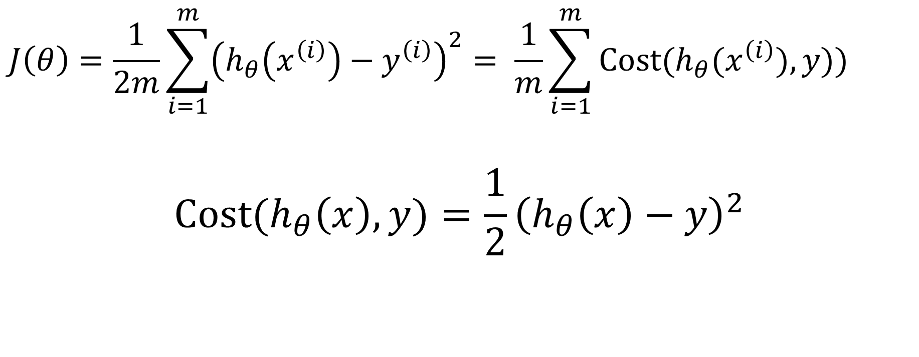
Cost function for Linear Regression
$$J\left(θ\right)=\frac{1}{2m}\sum_{i=1}^{m}{{\left(h_{θ}\left(x^{\left(i\right)}\right)−y^{\left(i\right)}\right)}^{2}}= \frac{1}{m}\sum_{i=1}^{m}{Cost(h_{θ}(x^{\left(i\right)}),y))}$$
$$Cost(h_{θ}\left(x\right),y)=\frac{1}{2}{\left(h_{θ}\left(x\right)−y\right)}^{2}$$

Slide 18



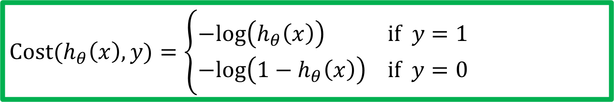





Cost function for Logistic Regression
$$Cost(h_{θ}\left(x\right),y)=\left\{\begin{aligned}−log\left(h_{θ}\left(x\right)\right) if y=1 \\ −log\left({1−h}_{θ}\left(x\right)\right) if y=0\end{aligned}\right.$$
$$if y=1$$
$$if y=0$$
$$0$$
$$h_{θ}\left(x\right)$$
$$1$$
$$0$$
$$h_{θ}\left(x\right)$$
$$1$$

Slide 19
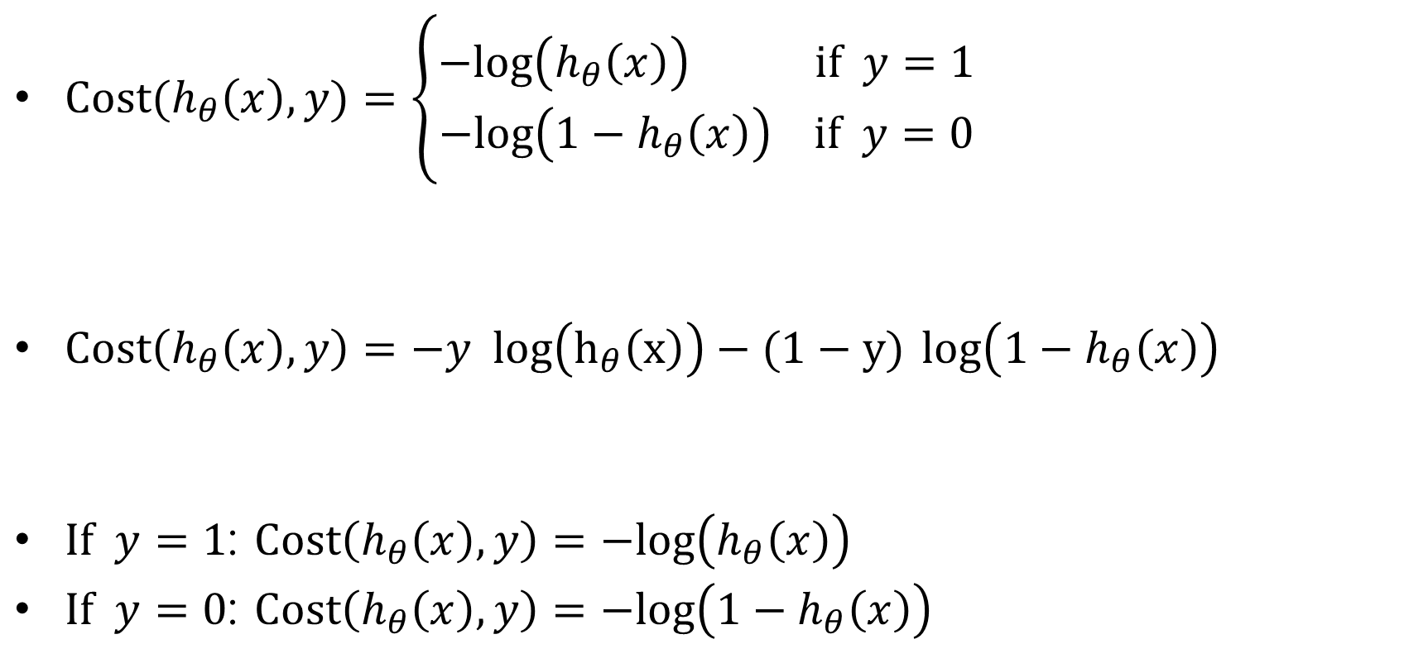
Logistic regression cost function
$Cost(h_{θ}\left(x\right),y)=\left\{\begin{aligned}−log\left(h_{θ}\left(x\right)\right) if y=1 \\ −log\left({1−h}_{θ}\left(x\right)\right) if y=0\end{aligned}\right.$
$Cost\left(h_{θ}\left(x\right),y\right)=−y log\left(h_{θ}\left(x\right)\right)−(1−y)$ $log\left({1−h}_{θ}\left(x\right)\right)$
$If y=1$: $Cost\left(h_{θ}\left(x\right),y\right)=−log\left(h_{θ}\left(x\right)\right)$
$If y=0$: $Cost\left(h_{θ}\left(x\right),y\right)=−log\left({1−h}_{θ}\left(x\right)\right)$

Slide 20
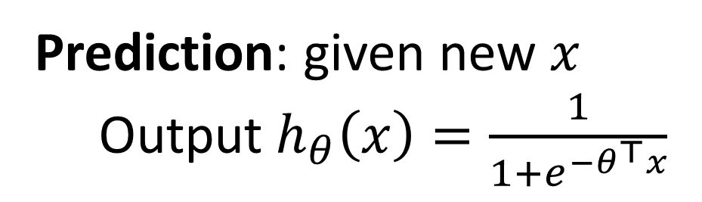

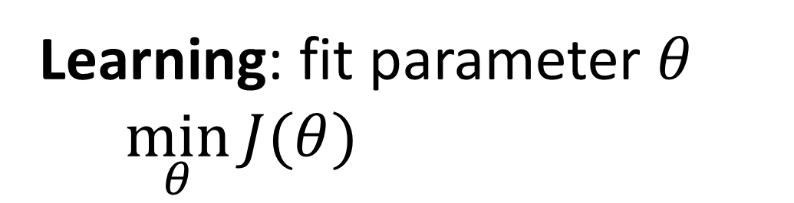
Logistic regression
$$J\left(θ\right)=\frac{1}{m}\sum_{i=1}^{m}{Cost(h_{θ}(x^{\left(i\right)}),y^{(i)}))}$$
$=−\frac{1}{m}\left[\sum_{i=1}^{m}{y^{(i)} log\left(h_{θ}\left(x^{(i)}\right)\right)+(1−y^{(i)}) log\left({1−h}_{θ}\left(x^{(i)}\right)\right)}\right]$
Learning: fit parameter $θ$
$\min_{θ}{J(θ)}$
Prediction: given new $x$
Output $h_{θ}\left(x\right)=\frac{1}{1+e^{−θ^{⊤}x}}$

Slide 21
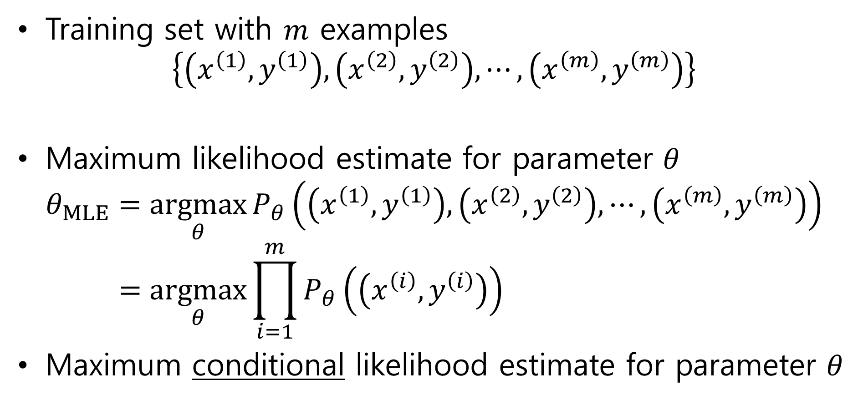
Where does the cost come from?
Training set with $m$ examples
$$\left\{\left(x^{\left(1\right)}, y^{\left(1\right)}\right), \left(x^{\left(2\right)}, y^{\left(2\right)}\right), ⋯,\left(x^{\left(m\right)}, y^{\left(m\right)}\right)\right\}$$
Maximum likelihood estimate for parameter $θ$
$$θ_{MLE}=\underset{θ}{argmax}{P_{θ}\left(\left(x^{\left(1\right)}, y^{\left(1\right)}\right), \left(x^{\left(2\right)}, y^{\left(2\right)}\right), ⋯,\left(x^{\left(m\right)}, y^{\left(m\right)}\right)\right)} \\ =\underset{θ}{argmax}{\prod_{i=1}^{m}{P_{θ}\left(\left(x^{\left(i\right)}, y^{\left(i\right)}\right)\right)}}$$
Maximum conditional likelihood estimate for parameter $θ$

Slide 22

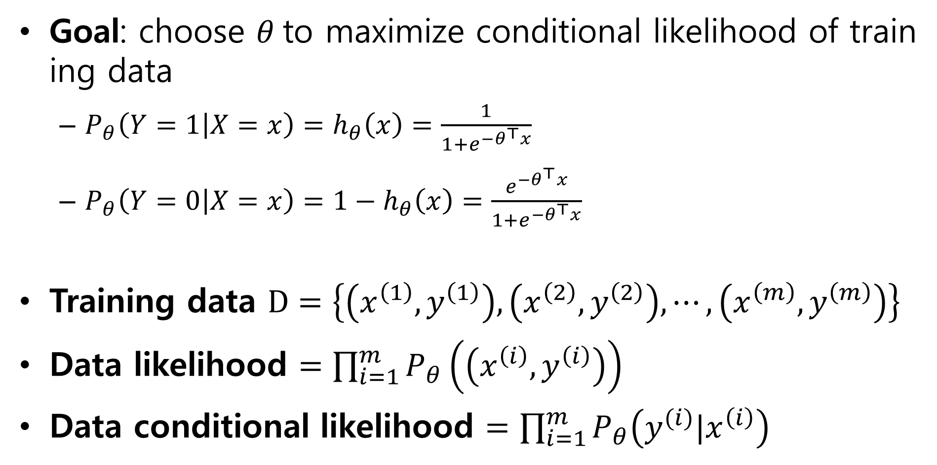
Goal: choose $θ$to maximize conditional likelihood of training data
$P_{θ}\left(Y=1 | X=x\right)=h_{θ}\left(x\right)=\frac{1}{1+e^{{−θ}^{⊤}x}}$
$P_{θ}\left(Y=0 | X=x\right)=1−h_{θ}\left(x\right)=\frac{e^{{−θ}^{⊤}x}}{1+e^{{−θ}^{⊤}x}}$
Training data $D=\left\{\left(x^{\left(1\right)}, y^{\left(1\right)}\right), \left(x^{\left(2\right)}, y^{\left(2\right)}\right), ⋯,\left(x^{\left(m\right)}, y^{\left(m\right)}\right)\right\}$
Data likelihood $=\prod_{i=1}^{m}{P_{θ}\left(\left(x^{\left(i\right)}, y^{\left(i\right)}\right)\right)}$
Data conditional likelihood $=\prod_{i=1}^{m}{P_{θ}\left(y^{(i)}|x^{\left(i\right)}\right)}$
$θ_{MCLE}=\underset{θ}{argmax}$ $\prod_{i=1}^{m}{P_{θ}\left(y^{(i)}|x^{\left(i\right)}\right)}$

Slide 23
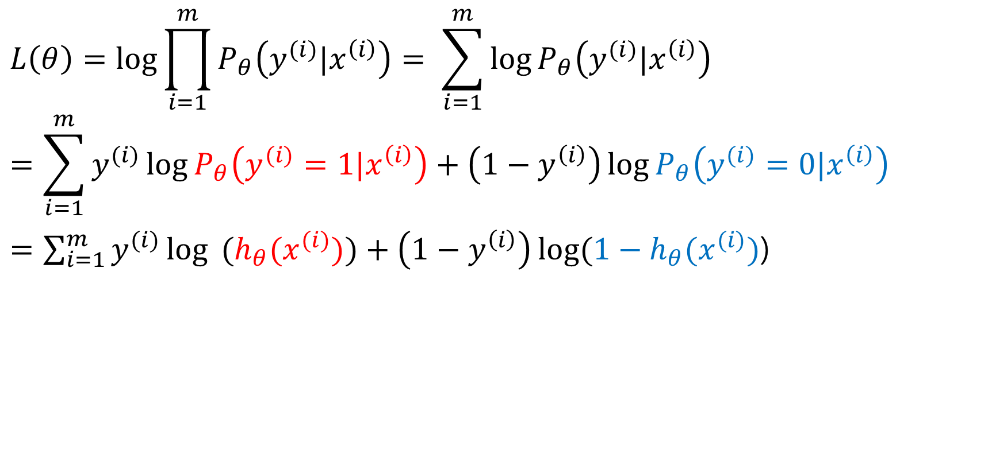
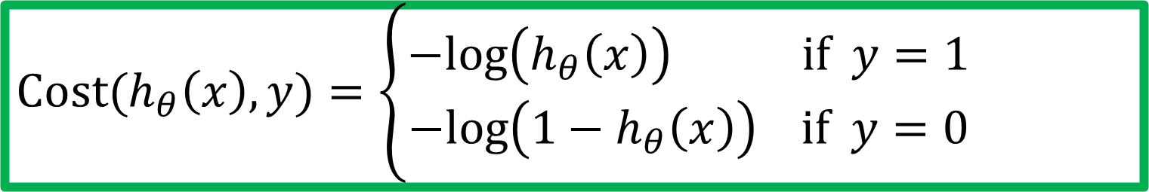
Expressing conditional log-likelihood
$$L\left(θ\right)=\log{\prod_{i=1}^{m}{P_{θ}\left(y^{(i)}|x^{\left(i\right)}\right)}}= \sum_{i=1}^{m}{\log{P_{θ}\left(y^{(i)}|x^{\left(i\right)}\right)}}$$
$$=\sum_{i=1}^{m}{y^{(i)}\log{P_{θ}\left(y^{(i)}=1|x^{\left(i\right)}\right)}}+\left(1−y^{\left(i\right)}\right)\log{P_{θ}\left(y^{(i)}=0|x^{\left(i\right)}\right)}$$
$=\sum_{i=1}^{m}{y^{(i)}\log{ (h_{θ}(x^{(i)})})}+\left(1−y^{\left(i\right)}\right)\log{(1−h_{θ}(x^{(i)})}$)
$$Cost(h_{θ}\left(x\right),y)=\left\{\begin{aligned}−log\left(h_{θ}\left(x\right)\right) if y=1 \\ −log\left({1−h}_{θ}\left(x\right)\right) if y=0\end{aligned}\right.$$

Slide 24
Logistic Regression
Hypothesis representation
Cost function
Logistic regression with gradient descent
Regularization
Multi-class classification

Slide 25
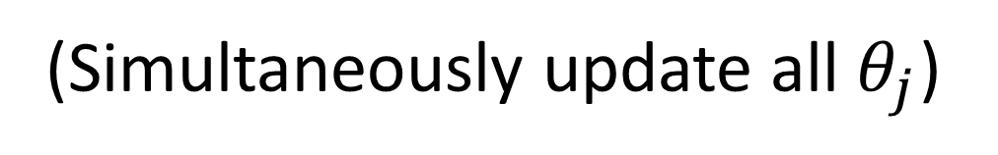

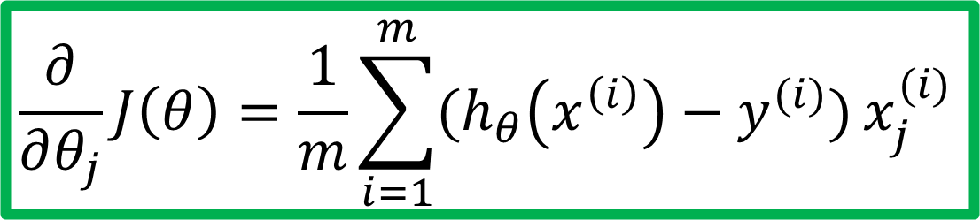
Gradient descent
$$J\left(θ\right)=−\frac{1}{m}\left[\sum_{i=1}^{m}{y^{(i)} log\left(h_{θ}\left(x^{(i)}\right)\right)+(1−y^{(i)}) log\left({1−h}_{θ}\left(x^{(i)}\right)\right)}\right]$$
Goal: $\min_{θ}{J(θ)}$
Repeat {
$$θ_{j}≔θ_{j}−α\frac{∂}{∂θ_{j}}J(θ)$$
}
Good news: Convex function!
Bad news: No analytical solution
(Simultaneously update all $θ_{j}$)
$$\frac{∂}{∂θ_{j}}J\left(θ\right)=\frac{1}{m}\sum_{i=1}^{m}{(h_{θ}\left(x^{\left(i\right)}\right)−y^{(i)})}x_{j}^{(i)}$$

Slide 26
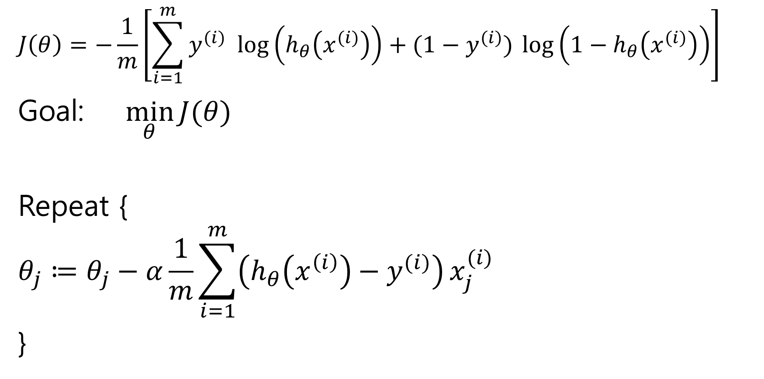
Gradient descent
$$J\left(θ\right)=−\frac{1}{m}\left[\sum_{i=1}^{m}{y^{(i)} log\left(h_{θ}\left(x^{(i)}\right)\right)+(1−y^{(i)}) log\left({1−h}_{θ}\left(x^{(i)}\right)\right)}\right]$$
Goal: $\min_{θ}{J(θ)}$
Repeat {
$$θ_{j}≔θ_{j}−α\frac{1}{m}\sum_{i=1}^{m}{\left(h_{θ}\left(x^{\left(i\right)}\right)−y^{(i)}\right)}x_{j}^{(i)}$$
}
(Simultaneously update all $θ_{j}$)

Slide 27
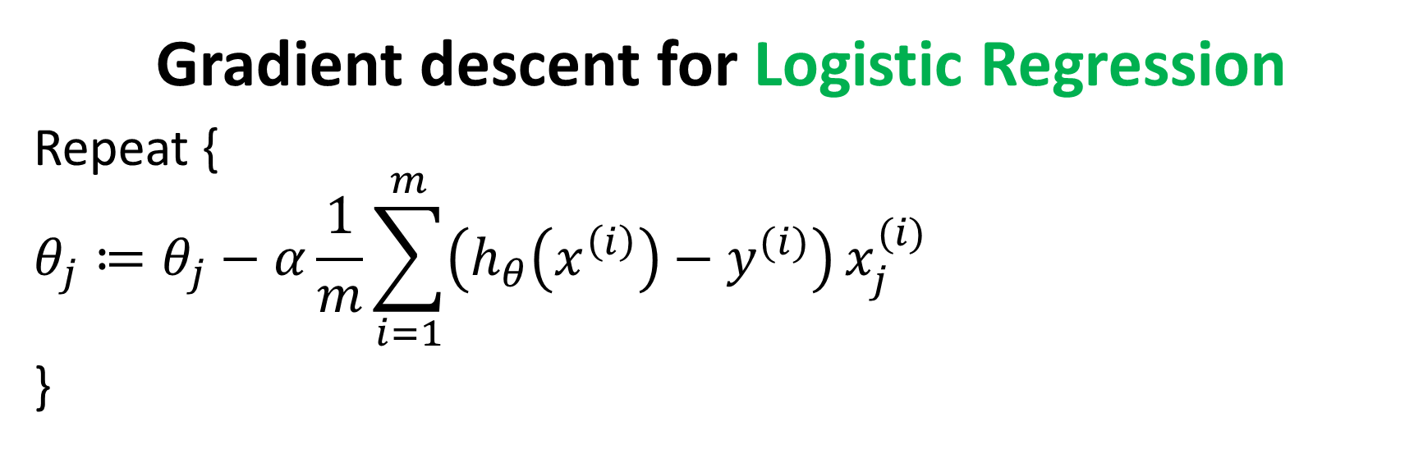
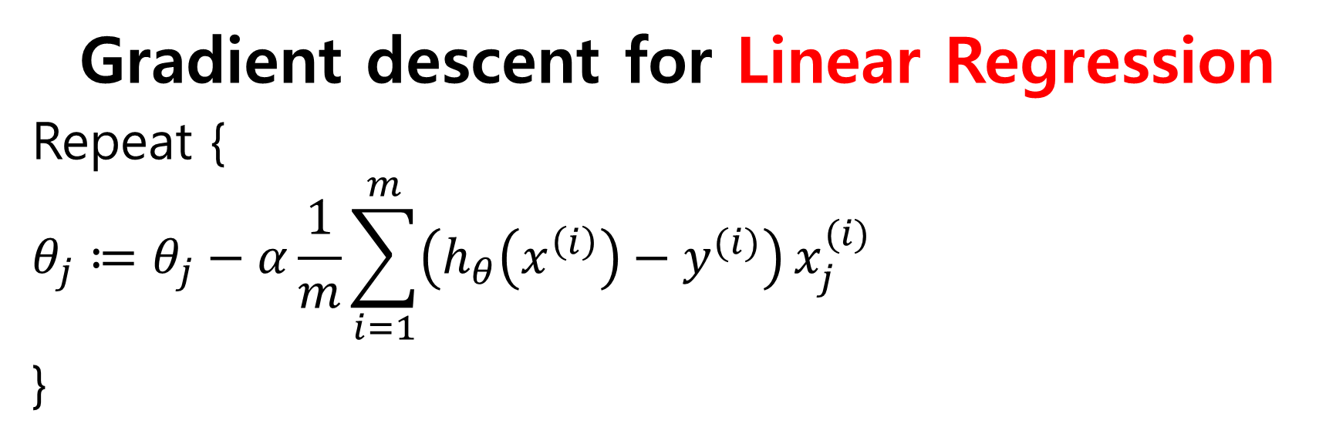
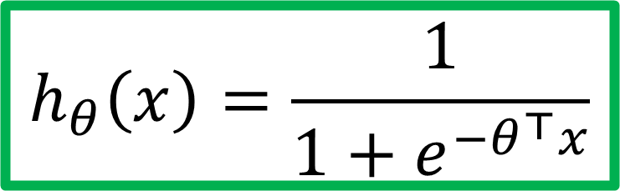

Gradient descent for Linear Regression
Repeat {
$$θ_{j}≔θ_{j}−α\frac{1}{m}\sum_{i=1}^{m}{\left(h_{θ}\left(x^{\left(i\right)}\right)−y^{(i)}\right)}x_{j}^{(i)}$$
}
$$h_{θ}\left(x\right)=θ^{⊤}x$$
Gradient descent for Logistic Regression
Repeat {
$$θ_{j}≔θ_{j}−α\frac{1}{m}\sum_{i=1}^{m}{\left(h_{θ}\left(x^{\left(i\right)}\right)−y^{(i)}\right)}x_{j}^{(i)}$$
}
$$h_{θ}\left(x\right)=\frac{1}{1+e^{−θ^{⊤}x}}$$

Slide 28
Logistic Regression
Hypothesis representation
Cost function
Logistic regression with gradient descent
Regularization
Multi-class classification

Slide 29


How about MAP?
Maximum conditional likelihood estimate (MCLE)
Maximum conditional a posterior estimate (MCAP)
$θ_{MCLE}=\underset{θ}{argmax}$ $\prod_{i=1}^{m}{P_{θ}\left(y^{(i)}|x^{\left(i\right)}\right)}$
$θ_{MCAP}=\underset{θ}{argmax}$ $\prod_{i=1}^{m}{P_{θ}\left(y^{(i)}|x^{\left(i\right)}\right)P(θ)}$

Slide 30
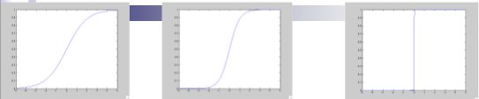
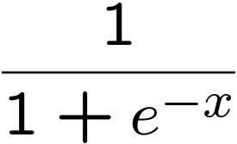
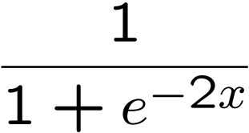
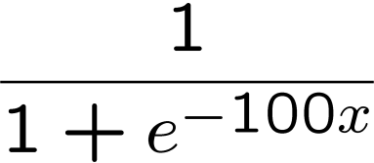
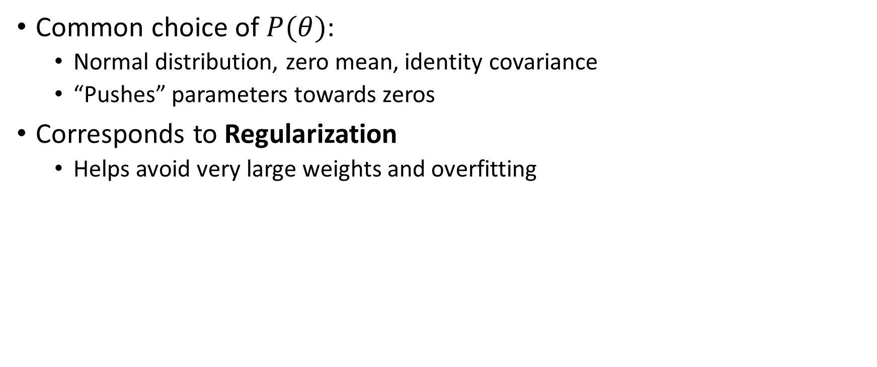

Prior $P(θ)$
Common choice of $P(θ)$:
Normal distribution, zero mean, identity covariance
“Pushes” parameters towards zeros
Corresponds to Regularization
Helps avoid very large weights and overfitting

Slide 31
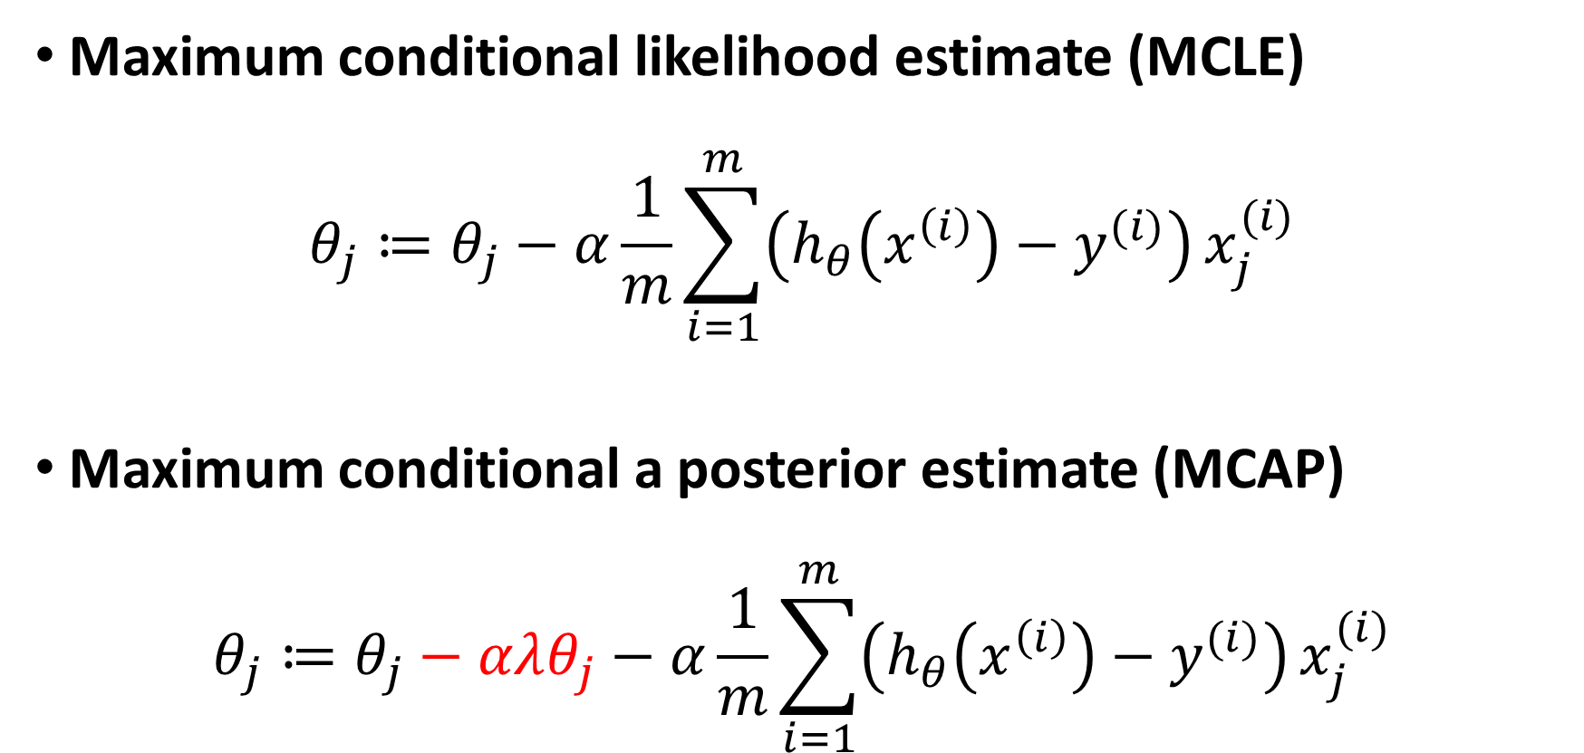
MLE vs. MAP
Maximum conditional likelihood estimate (MCLE)
$$θ_{j}≔θ_{j}−α\frac{1}{m}\sum_{i=1}^{m}{\left(h_{θ}\left(x^{\left(i\right)}\right)−y^{(i)}\right)}x_{j}^{(i)}$$
Maximum conditional a posterior estimate (MCAP)
$$θ_{j}≔θ_{j}−αλθ_{j}−α\frac{1}{m}\sum_{i=1}^{m}{\left(h_{θ}\left(x^{\left(i\right)}\right)−y^{(i)}\right)}x_{j}^{(i)}$$

Slide 32
Logistic Regression
Hypothesis representation
Cost function
Logistic regression with gradient descent
Regularization
Multi-class classification

Slide 33
Multi-class classification
Email foldering/taggning: Work, Friends, Family, Hobby
Medical diagrams: Not ill, Cold, Flu
Weather: Sunny, Cloudy, Rain, Snow

Slide 34




Binary classification
Multiclass classification
$$x_{2}$$
$$x_{2}$$
$$x_{1}$$
$$x_{1}$$

Slide 35





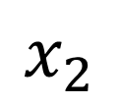




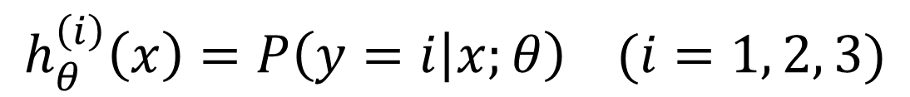

One-vs-all (one-vs-rest)
$$x_{2}$$
$$h_{θ}^{\left(1\right)}\left(x\right)$$
$$x_{1}$$
$$x_{2}$$
$$x_{2}$$
$$h_{θ}^{\left(2\right)}\left(x\right)$$
$$x_{1}$$
$$x_{1}$$
Class 1:
Class 2:
Class 3:
$$h_{θ}^{\left(3\right)}\left(x\right)$$
$$x_{2}$$
$$h_{θ}^{\left(i\right)}\left(x\right)=P\left(y=i | x;θ\right) (i=1, 2, 3)$$
$$x_{1}$$

Slide 36
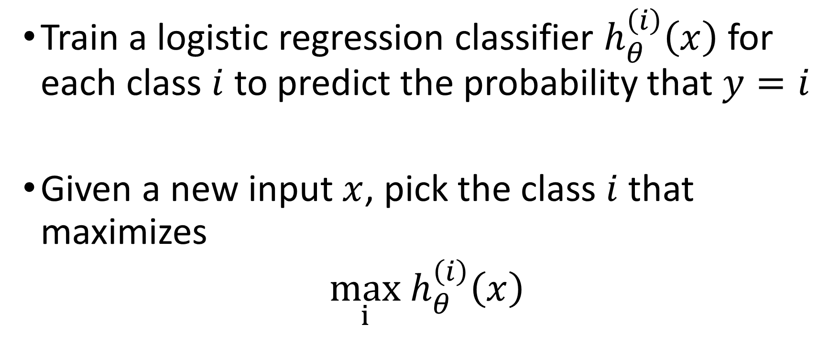
One-vs-all
Train a logistic regression classifier $h_{θ}^{\left(i\right)}\left(x\right)$ for each class $i$ to predict the probability that $y=i$
Given a new input $x$, pick the class $i$that maximizes
$\max_{i}$ $h_{θ}^{\left(i\right)}\left(x\right)$

Slide 37
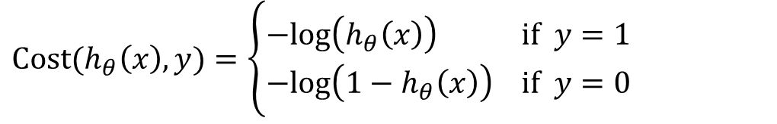
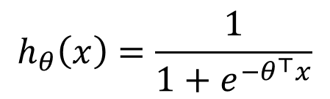
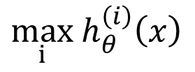


Things to remember
Hypothesis representation
Cost function
Logistic regression with gradient descent
Regularization
Multi-class classification
$$h_{θ}\left(x\right)=\frac{1}{1+e^{−θ^{⊤}x}}$$
$$Cost(h_{θ}\left(x\right),y)=\left\{\begin{aligned}−log\left(h_{θ}\left(x\right)\right) if y=1 \\ −log\left({1−h}_{θ}\left(x\right)\right) if y=0\end{aligned}\right.$$
$$θ_{j}≔θ_{j}−α\frac{1}{m}\sum_{i=1}^{m}{\left(h_{θ}\left(x^{\left(i\right)}\right)−y^{(i)}\right)}x_{j}^{(i)}$$
$$θ_{j}≔θ_{j}−αλθ_{j}−α\frac{1}{m}\sum_{i=1}^{m}{\left(h_{θ}\left(x^{\left(i\right)}\right)−y^{(i)}\right)}x_{j}^{(i)}$$
$\max_{i}$ $h_{θ}^{\left(i\right)}\left(x\right)$

Slide 38
Nonlinear Regression and Classification Algorithms

Slide 39
(KNN) K-Nearest Neighbors Algorithm

Slide 40


(KNN) K-Nearest Neighbors
K-Nearest Neighbor is a supervised learning algorithm both for classification and regression.
The principle is to find the predefined number of training samples closest to the new point, and predict the label from these training samples.

Slide 41
What is k in KNN?
The parameter k in kNN refers to the number of neighbors considered for classification or regression.
The value of k indicates the number of these points used to determine the result.
Our task is to calculate the distance and identify which categories or values are closest to our unknown entity.

Slide 42
1-Nearest Neighbor
The parameter k in kNN refers to the number of labeled points (neighbors) considered for classification or regression

Slide 43
3-Nearest Neighbor

Slide 44



KNN

Slide 45
How is the k-distance calculated?
K-distance is the distance between data points and a given query point.
To calculate it, we have to pick a distance metric:
Euclidean distance
Manhattan distance
Minkowski distance
Hamming distance

Slide 46


Euclidean distance
The Euclidean distance between two points is the length of the straight line segment connecting them.
This most common distance metric is applied to real-valued vectors.

Slide 47


Manhattan distance
The Manhattan distance between two points is the sum of the absolute differences between the x and y coordinates of each point.

Slide 48

Hamming distance
Hamming distance is used to compare two binary vectors (also called data strings or bitstrings).
To calculate it, data first has to be translated into a binary system.

Slide 49

How does K-NN work?
The K-NN working can be explained on the basis of the below algorithm:
Step-1: Select the number K of the neighbors
Step-2: Calculate the distance of K number of neighbors
Step-3: Take the K nearest neighbors as per the calculated distance
Step-4: Among these k neighbors, count the number of the data points in each category.
Step-5: Assign the new data points to that category for which the number of the neighbor is maximum.
Step-6: Our model is ready.

Slide 50
(SVM) Support Vector Machine

Slide 51
(SVM) Support Vector Machine
Support Vector Machine or SVM is one of the most popular Supervised Learning algorithms, which is used for Classification as well as Regression problems.
The goal of the SVM algorithm is to create the best line or decision boundary that can segregate n-dimensional space into classes so that we can easily put the new data point in the correct category in the future.
This best decision boundary is called a hyperplane.

Slide 52

(SVM) Support Vector Machine
SVM chooses the extreme points/vectors that help in creating the hyperplane.
These extreme cases are called as support vectors, and hence algorithm is termed as Support Vector Machine.
Consider the below diagram in which there are two different categories that are classified using a decision boundary or hyperplane:

Slide 53

How do we find the right hyperplane?
How do we best segregate the two classes within the data?
The distance between the hyperplane and the nearest data point from either set is known as the margin.
The goal is to choose a hyperplane with the greatest possible margin between the hyperplane and any point within the training set, giving a greater chance of new data being classified correctly.
There will never be any data point inside the margin.

Slide 54
How do we find the right hyperplane?
“Select the hyper-plane which segregates the two classes better”.

Slide 58
Any of these would be fine..
..but which is best?

Slide 59





Large-margin Decision Boundary
The decision boundary should be as far away from the data of both classes as possible
We should maximize the margin, m
Distance between the origin and the line w^{t}x=-b is b/||w||
Class 2
m
Class 1

Slide 60
Finding the Decision Boundary
Let {x₁, ..., x_{n}} be our data set and let y_{i} ∈ {1,-1} be the class label of x_{i}
The decision boundary should classify all points correctly ⇒
To see this: when y=-1, we wish (wx+b)<1, when y=1, we wish (wx+b)>1. For support vectors, we wish y(wx+b)=1.
The decision boundary can be found by solving the following constrained optimization problem

Slide 61
Types of SVM
SVM can be of two types:
Linear SVM: Linear SVM is used for linearly separable data, which means if a dataset can be classified into two classes by using a single straight line, then such data is termed as linearly separable data, and classifier is used called as Linear SVM classifier.
Non-linear SVM: Non-Linear SVM is used for non-linearly separated data, which means if a dataset cannot be classified by using a straight line, then such data is termed as non-linear data and classifier used is called as Non-linear SVM classifier.

